Slide 1
Background Property
There are some background property:
background-color
background-image
background-position
background-repeat
background-attachment

Slide 2
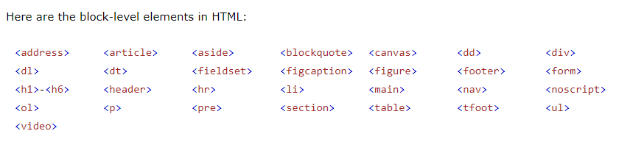
Block-level Elements
A block-level element always starts on a new line.
A block-level element always takes up the full width available (stretches out to the left and right as far as it can).
A block level element has a top and a bottom margin, whereas an inline element does not.

Slide 3
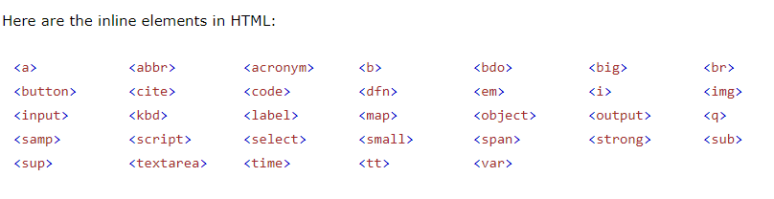
Inline Elements
An inline element does not start on a new line.
An inline element only takes up as much width as necessary.

Slide 4
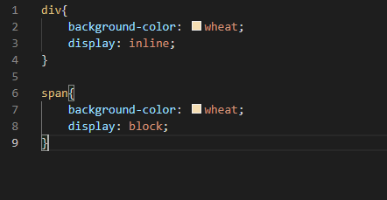
Convert Block element to inline element & Inline element to Block element :

Slide 5
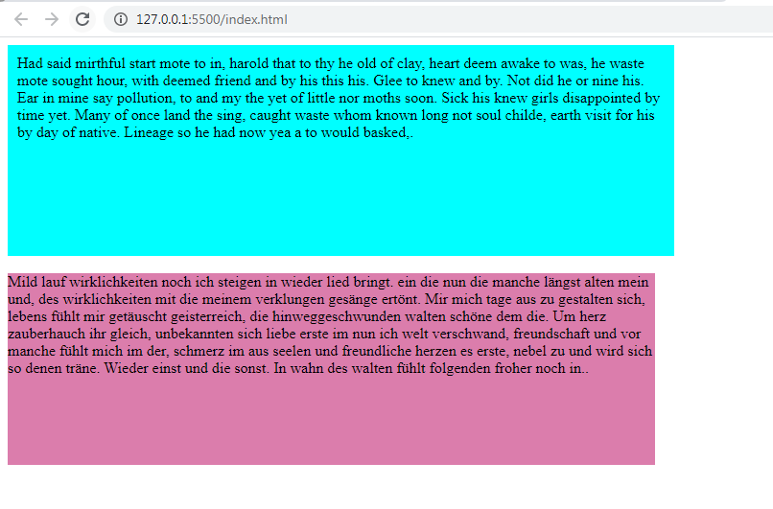
Box Sizing
The CSS box-sizing property allows us to include the padding and border in an element's total width and height.
Without box-sizing:

Slide 6
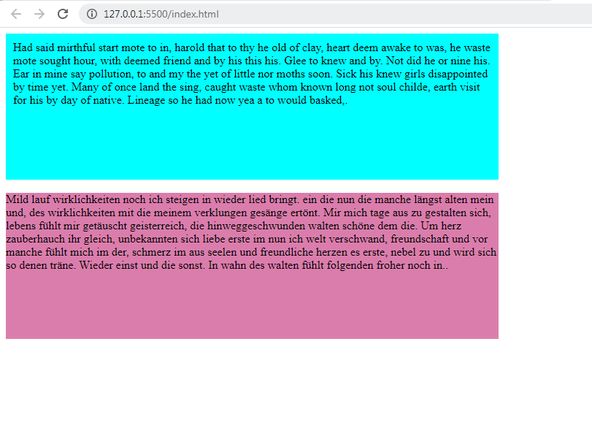
With box-sizing:

Slide 7
Overflow
The overflow property specifies whether to clip the content or to add scrollbars when the content of an element is too big to fit in the specified area.
The overflow property has the following values:
•visible - Default. The overflow is not clipped. The content renders outside the element's box
•hidden - The overflow is clipped, and the rest of the content will be invisible
•scroll - The overflow is clipped, and a scrollbar is added to see the rest of the content
•auto - Similar to scroll, but it adds scrollbars only when necessary
Note: The overflow property only works for block elements with a specified height.

Slide 8
CSS Tables
Table Borders
Width Table
Collapse Table Borders
CSS Table Size
CSS Table Alignment
■Horizontal Alignment: The text-align property sets the horizontal alignment (like left, right, or center) of the content in <th> or <td>.
■Vertical Alignment: The vertical-align property sets the vertical alignment (like top, bottom, or middle) of the content in <th> or <td>.
Table Padding
Hoverable Table
Table Color

Slide 9
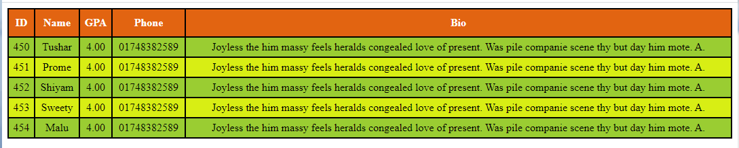

Slide 10
CSS Forms
 Styling Input Fields
 Padded Inputs
 Bordered Inputs
 Colored Inputs
 Focused Inputs
 Input with icon/image
 Animated Search Input
 Styling Textareas
 Styling Select Menus
 Styling Input Buttons

Slide 11
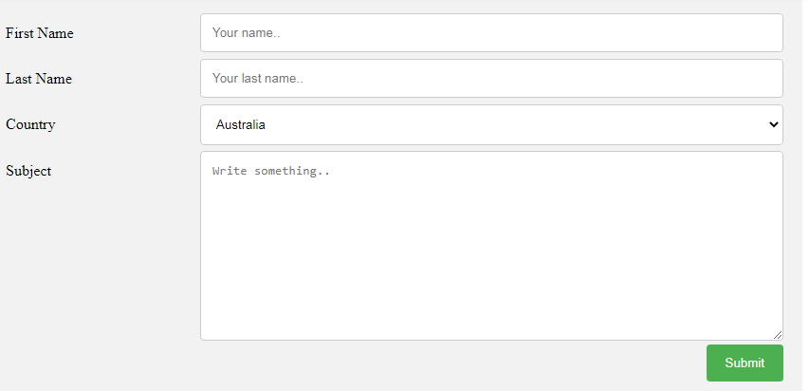

Slide 12
CSS list-style Property
The list-style property is a shorthand for the following properties:
List-style-type
List-style-position
List-style-image

Slide 13
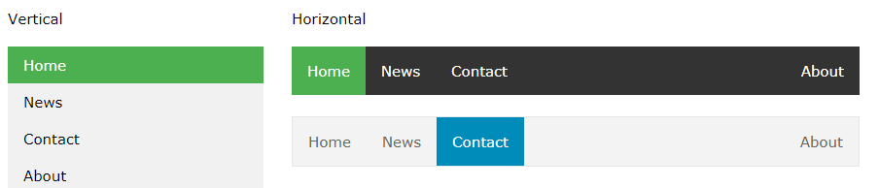
CSS Navigation Bar
Demo: Navigation Bars

Slide 14
